Slide 1

Capstone Project Hotel Booking Analysis
PRAPARED BY
PANKAJ KUMAR

Slide 2
PROBLEM STATEMENT
The hotel industry is a competitive market, where hotels need to optimize their booking strategies to attract more customers and increase their revenue.The provided hotel booking dataset contains valuable information that can help hotels understand how to attract more bookings and optimize their pricing strategies. The goal of this project is to use this data to explore and analyze various factors that govern the bookings such as the best time of year to book a hotel room, the optimal length of stay in order to get the best daily rate, and to predict whether or not a hotel is likely to receive a disproportionately high number of special requests. By understanding these factors, hotels can make informed decisions to improve their booking strategies and increase their revenue.

Slide 3
PROJECT WORK FLOW:
DATA CLEANING: Removing NULL Values,Duplicate Values,Feature Construction are done.
UNIVARIATE ANALYSIS: Univariate Analysis is done by taking only one variable into consideration.
BIVARIATE ANALYSIS: Bivariate Analysis is done by taking two variable into consideration.
MULTIVARIATE ANALYSIS: Multivariate Analysis is done by taking more than two variable into consideration.

Slide 4
DATA DESCRIPTION
hotel :Resort Hotel or City Hotel
is_canceled : Value indicating if the booking was canceled (1) or not (0)
lead_time : Number of days that elapsed between the entering date of the booking and the arrival date
arrival_date_year : Year of arrival date
arrival_date_month : Month of arrival date
arrival_date_week_number : Week number of year for arrival date
arrival_date_day_of_month : Day of arrival date
stays_in_weekend_nights : Number of weekend nights
stays_in_week_nights : Number of week nights.
adults : Number of adults
children : Number of children
babies : Number of babies
meal : Type of meal booked.
country : Country of origin.

Slide 5
market_segment : Market segment designation. (TA/TO)
distribution_channel : Booking distribution channel.(T/A/TO)
is_repeated_guest : is a repeated guest (1) or not (0)
previous_cancellations : Number of previous bookings that were cancelled by the customer prior to the current booking
previous_bookings_not_canceled : Number of previous bookings not cancelled by the customer prior to the current booking
reserved_room_type : Code of room type reserved.
assigned_room_type : Code for the type of room assigned to the booking.
booking_changes : Number of changes made to the booking from the moment the booking was entered on the PMS until the moment
check in or cancellation.
deposit_type : No Deposit, Non Refund , Refundable.
agent : ID of the travel agency that made the booking
company : ID of the company/entity that made the booking .
days_in_waiting_list : Number of days the booking was in the waiting list before it was confirmed to the customer
customer_type : type of customer. Contract,Group,transient,Transient party.
adr : Average Daily Rate as defined by dividing the sum of all lodging transactions by the total number of staying nights
required_car_parking_spaces : Number of car parking spaces required by the customer
total_of_special_requests : Number of special requests made by the customer (e.g. twin bed or high floor)
reservation_status : Reservation last status.

Slide 6
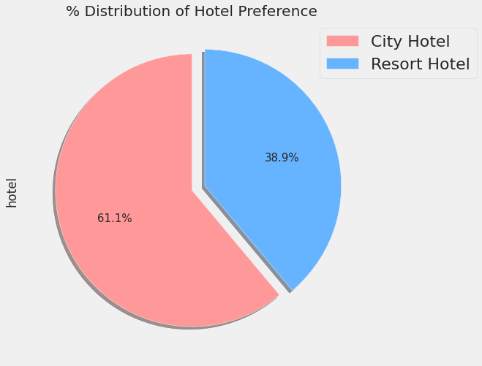
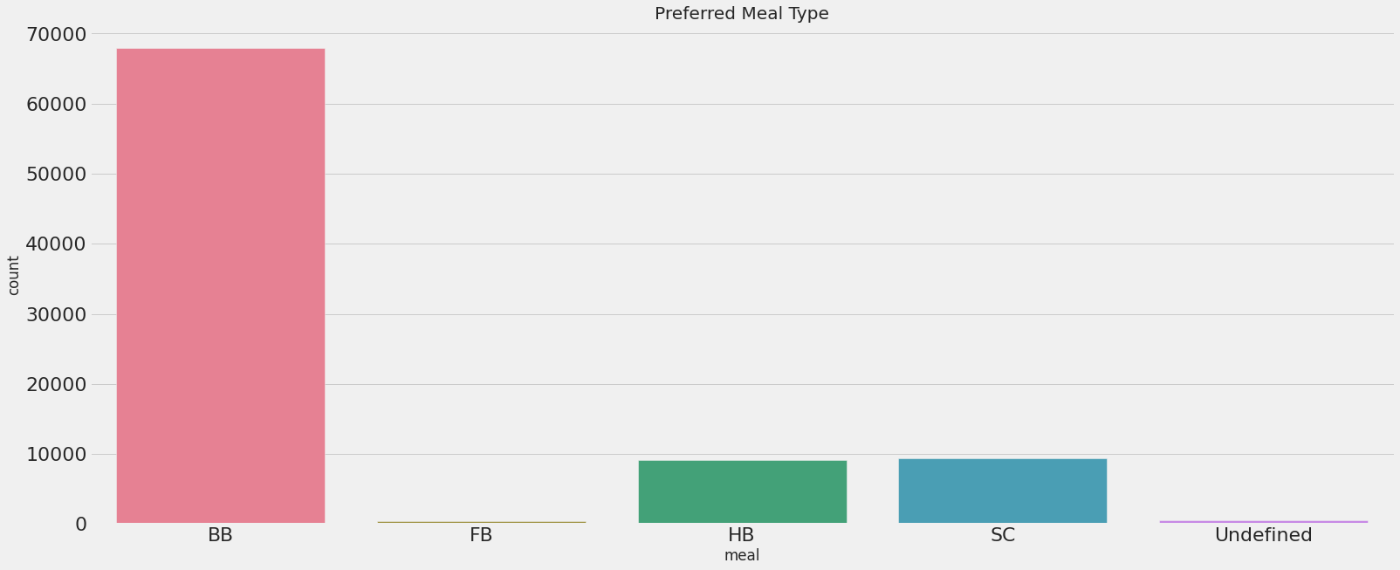
EXPLORATORY DATA ANALYSIS
CONCLUSIONS:
1.City Hotel is the most preferred hotel by the guest.Around 61% of the guest preferred city hotel and 39% of guest preferred Resort Hotel.
2.The most preferred meal type by guest is BB(Bed & Breakfast) while HB(Half Board) and SC(Self catering) are equally preferred.

Slide 7
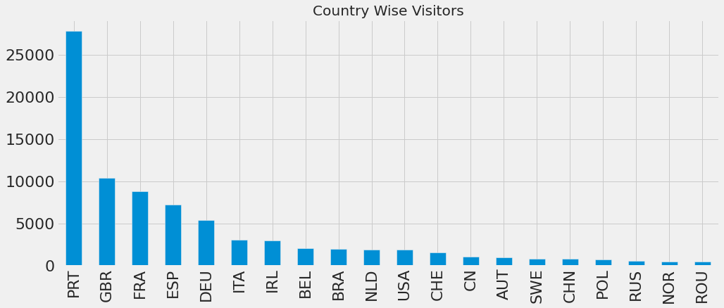
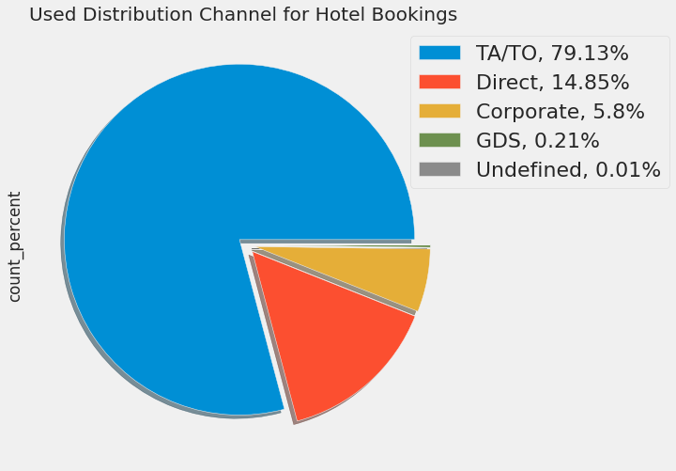
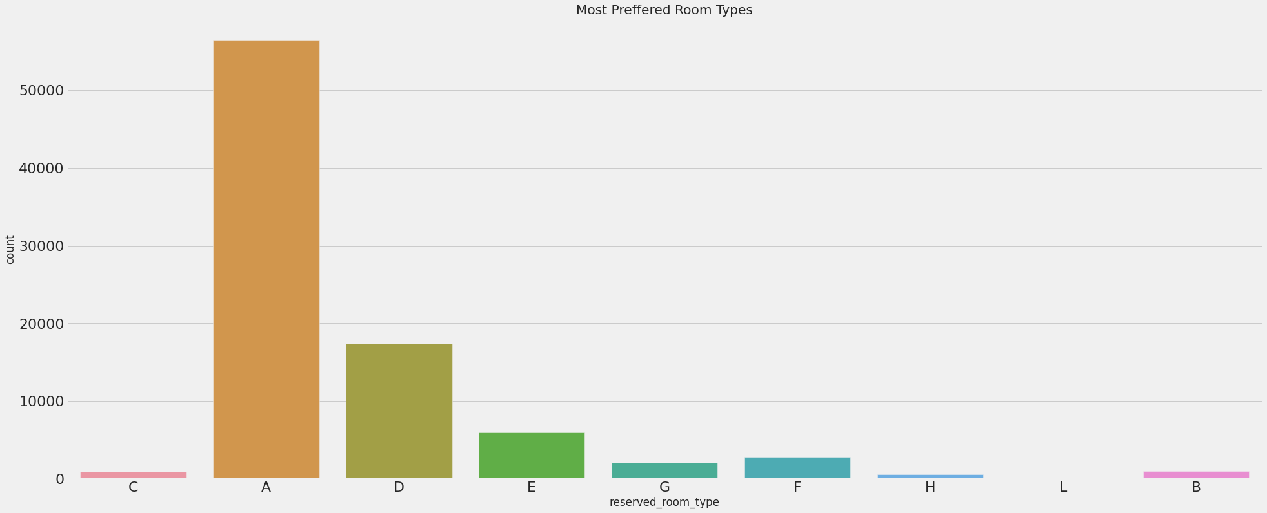
CONCLUSIONS:
Most visitors are from Portugal(PRT) more than 25000 followed by United Kingdom(GBR) around 10000.
'TA/TO' is mostly used for booking hotels.
Most Preferred Room type is by guest is "A“.

Slide 8
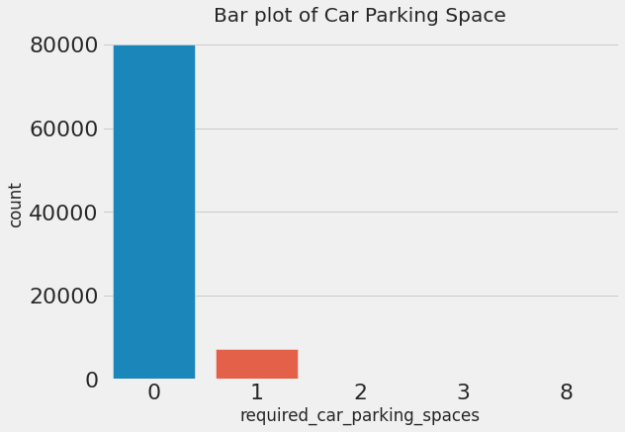
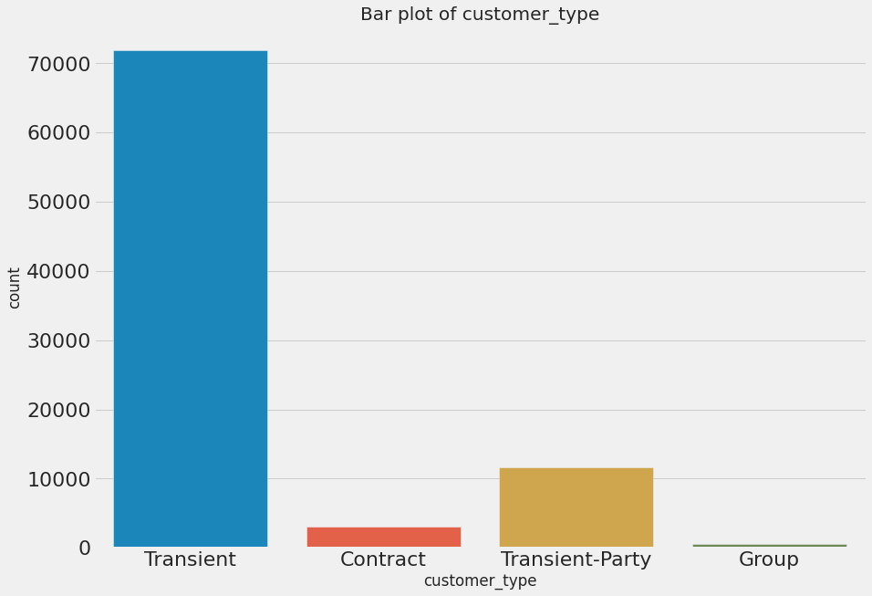
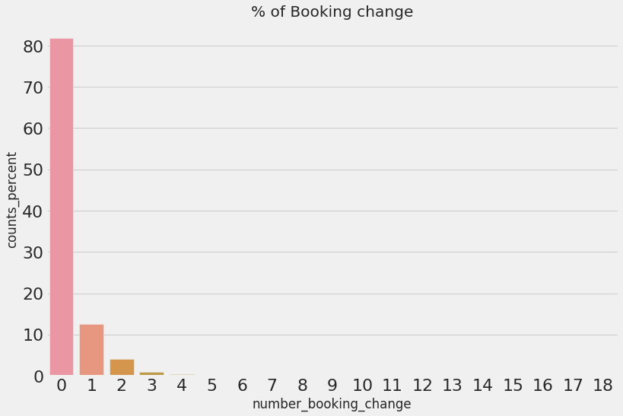
CONCLUSIONS:
Most guest does not need parking space at all only few guest asked for parking space of one car.
Transient Customer type is maximum While Group is minimum.
Most of the guests around 80% does't made any changes to the booking and around 12% of guest made one changes in their booking.

Slide 9
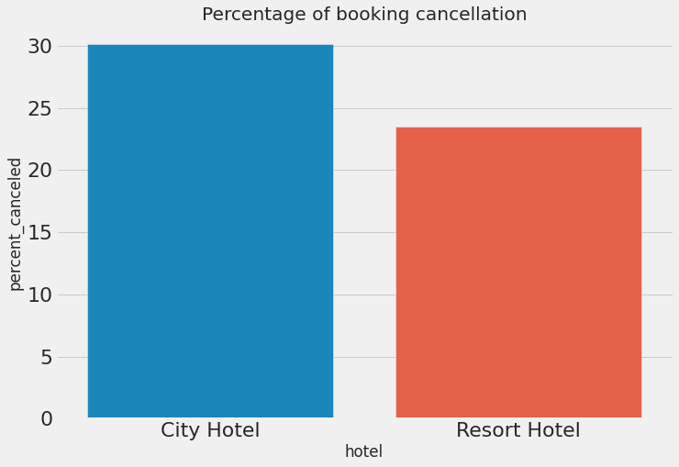
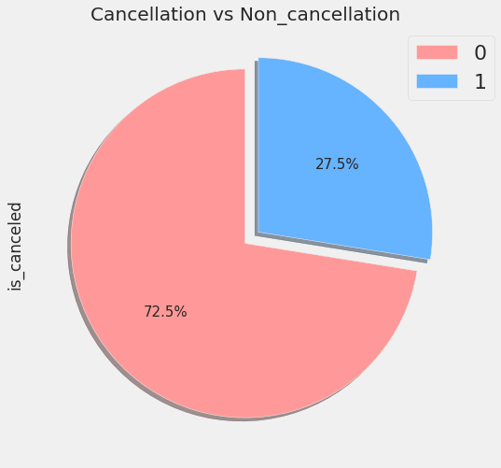
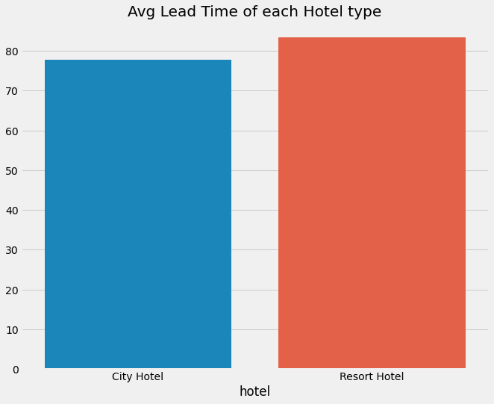
CONCLUSIONS:
Total 27.5% of booking were cancelled out of which 30% of cancellation comes from City Hotel and 24% of cancellation comes from Resort Hotel. So,City Hotel has higher rate of cancellation.
Resort hotel has slightly higher lead time in comparison to City hotel.

Slide 10
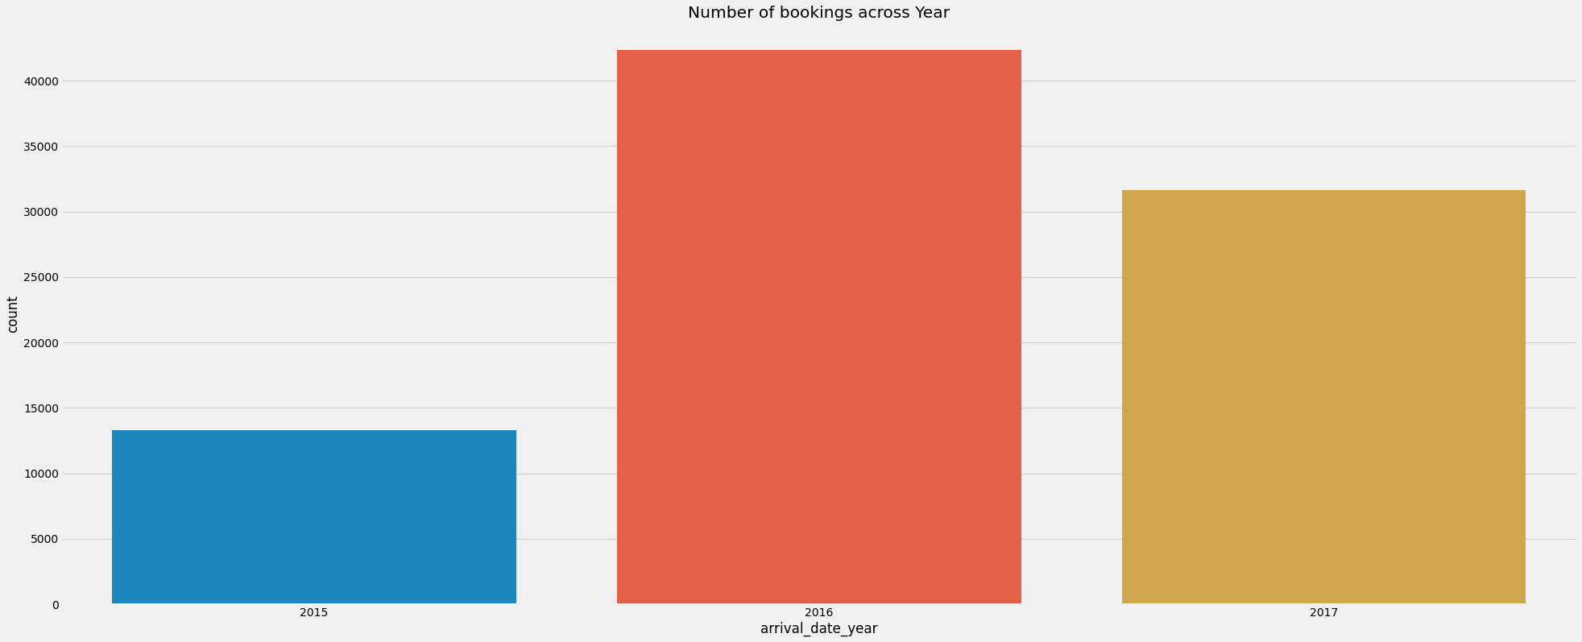
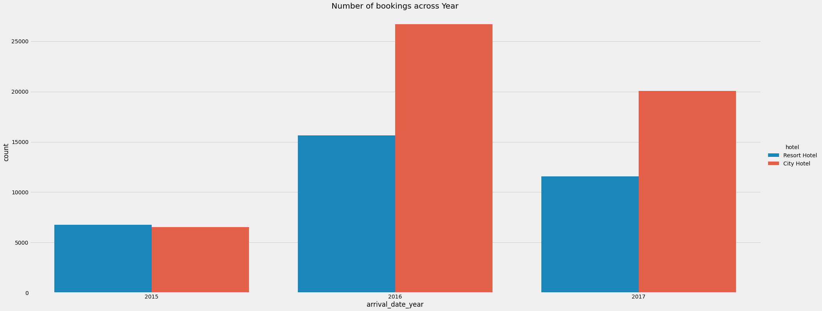
CONCLUSIONS:
2016 had been the best year for these hotels in terms of booking.
Year 2015 City Hotel and Resort Hotel had excatly same number of bookings but after 2015 City Hotel has more number of bookings.
Year 2016 City Hotel had more than 25000 bookings while Resort Hotel has around 15000 bookings whereas In 2017 City Hotel had around 20000 bookings while Resort Hotel had around 12000 bookings.

Slide 11
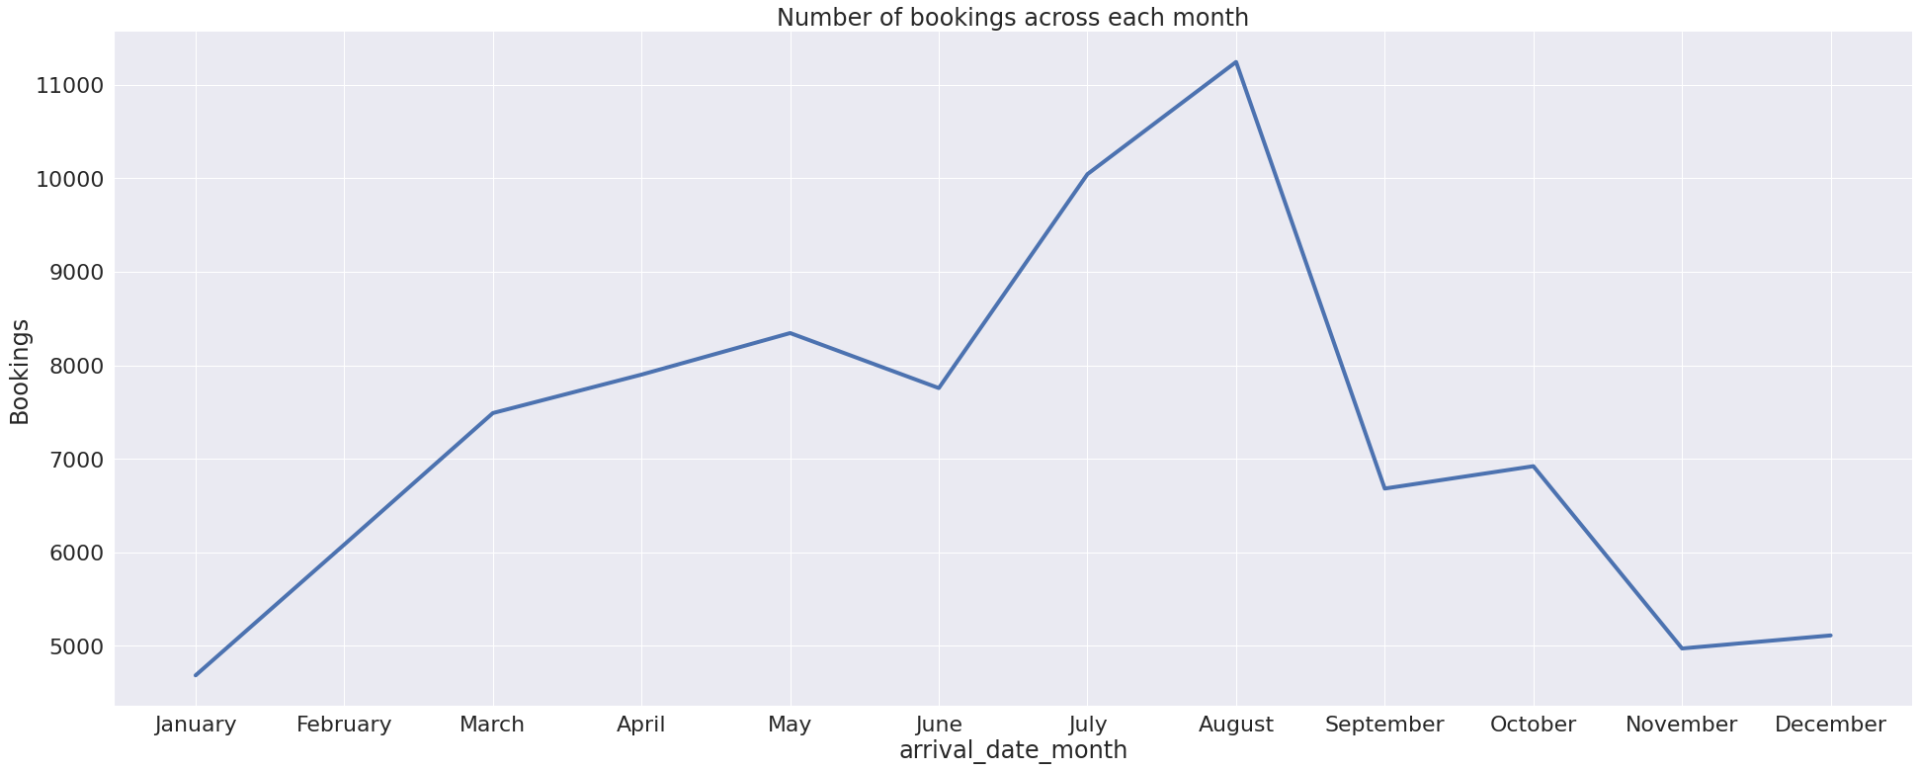
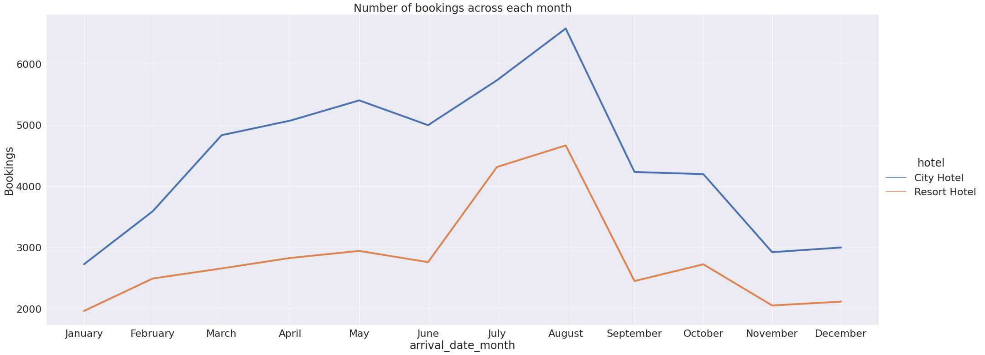
CONCLUSIONS:
July and August months had the most Bookings.
We can find similar trend in each month in each hotel.If City hotel has positive rate of change then resort hotel has also positive rate of change and if City hotel has negative rate of change then Resort Hotel has also negative rate of change although City Hotel has higher Positive rate of change.

Slide 12
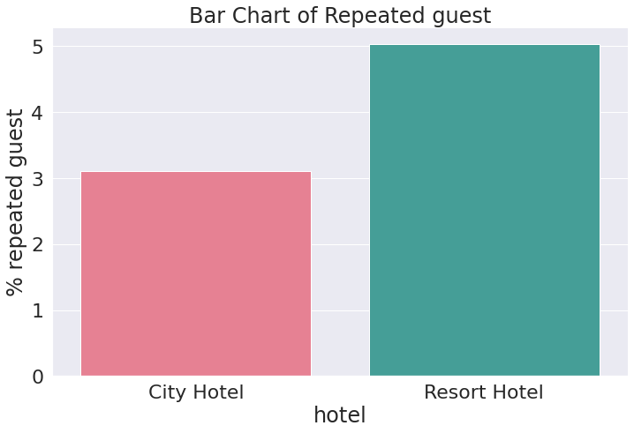
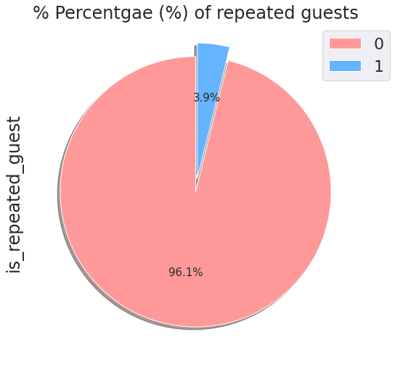
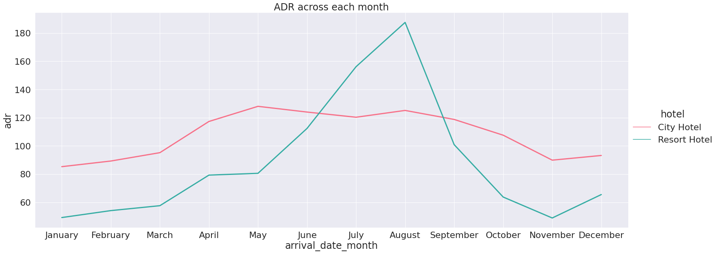
CONCLUSIONS:
Both the hotel has lower retention rate i.e 3.9% in which City hotel has retention rate of 3.11% and Resort hotel has retention rate of 5.02%
For Resort Hotel adr starts to increase from May and increases upto July after that is starts to decrease.
For City Hotel adr starts to increase from March and increases upto April after that is starts to decrease.

Slide 13
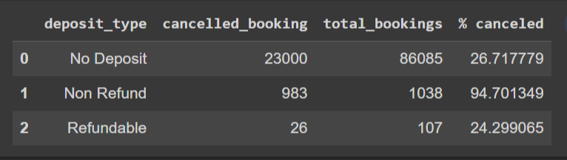
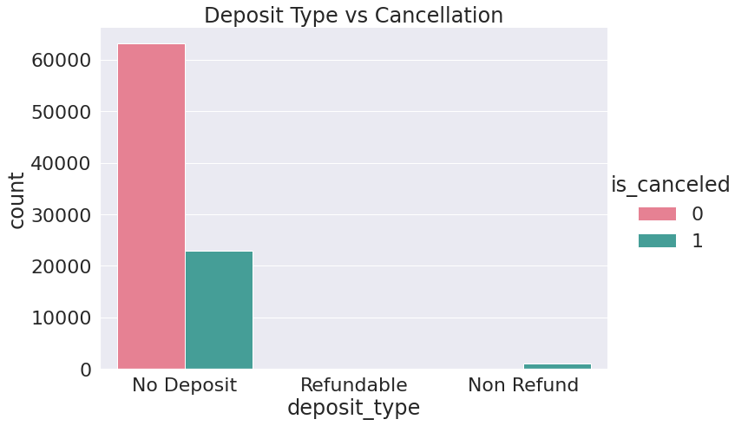
CONCLUSIONS:
Around 26% of bookings were cancelled by guests with no deposit.
So it's obvious that guests who do not pay any deposit while booking are likely to cancel more reservations. Also it is interesting to note that non-refundable deposits had more cancellation than refundable deposits. Logically one would have assumed that refundable deposits have more cancellation.

Slide 14
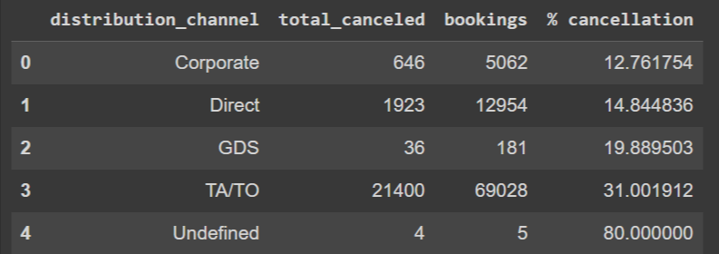
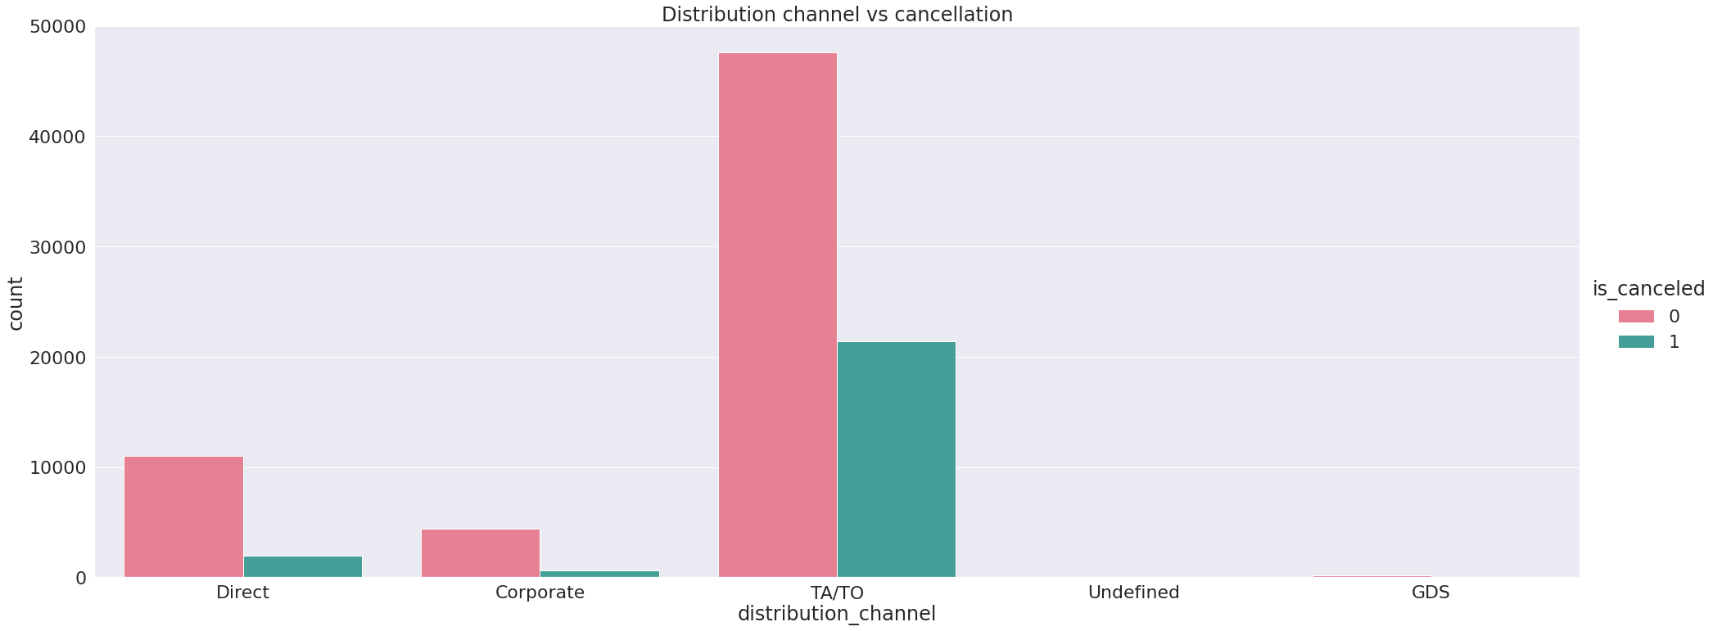
CONCLUSIONS:
Total 69028 bookings were made by TA/TO in which 21400 were cancelled which is approximately 31%.

Slide 15
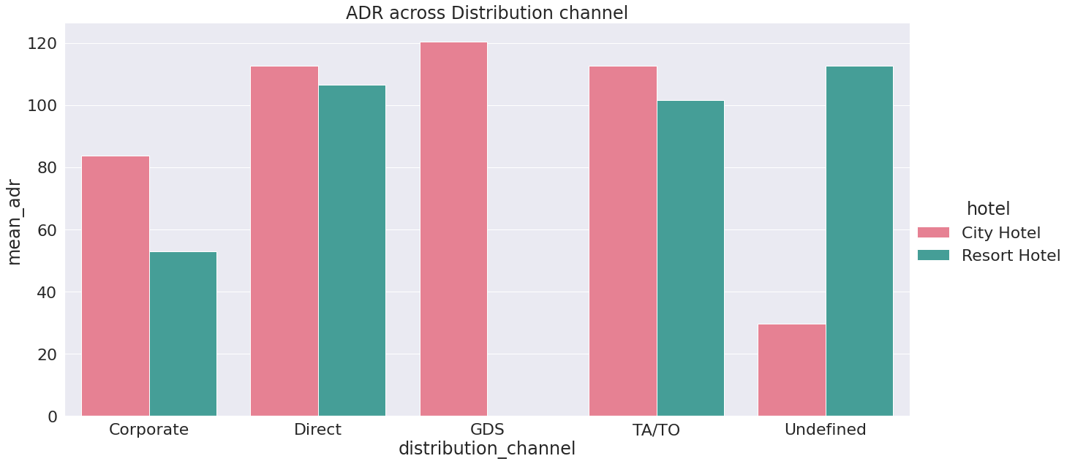
CONCLUSIONS:
Distribution Channnel "Direct" & "TA/TO" has contributed more in ADR in both the hotels.
Distribution Channel "GDS" has contributed in "City Hotel" only.

Slide 16
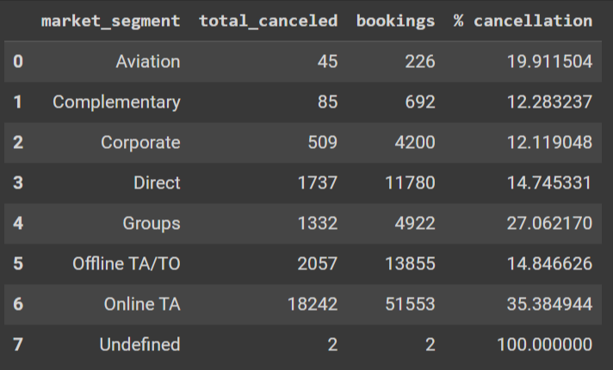
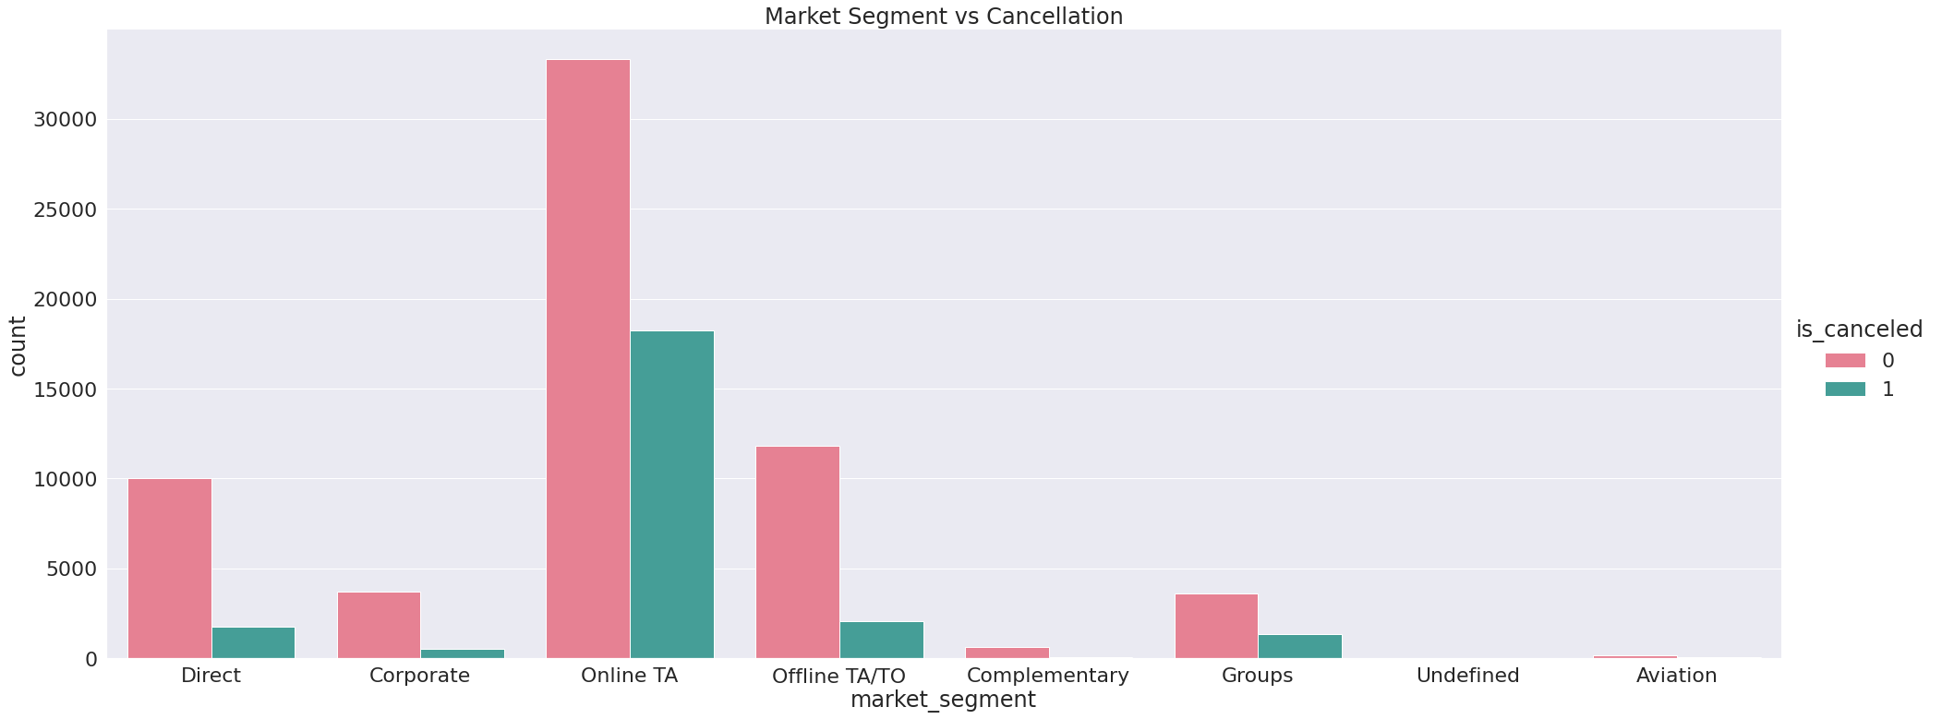
CONCLUSIONS:
"Online TA" has around 35% cancellation rate followed by Groups which has around 27% Cancellation rate.

Slide 17
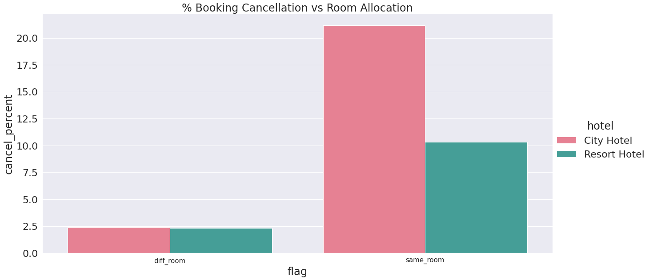
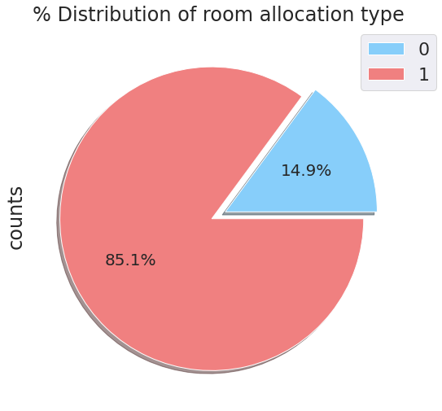
CONCLUSIONS:
Majority of people are getting room of their choices.
There is no much(2.5%) effect on cancellation of the bookings even if the guests are not assigned with rooms which they reserved during booking.

Slide 18
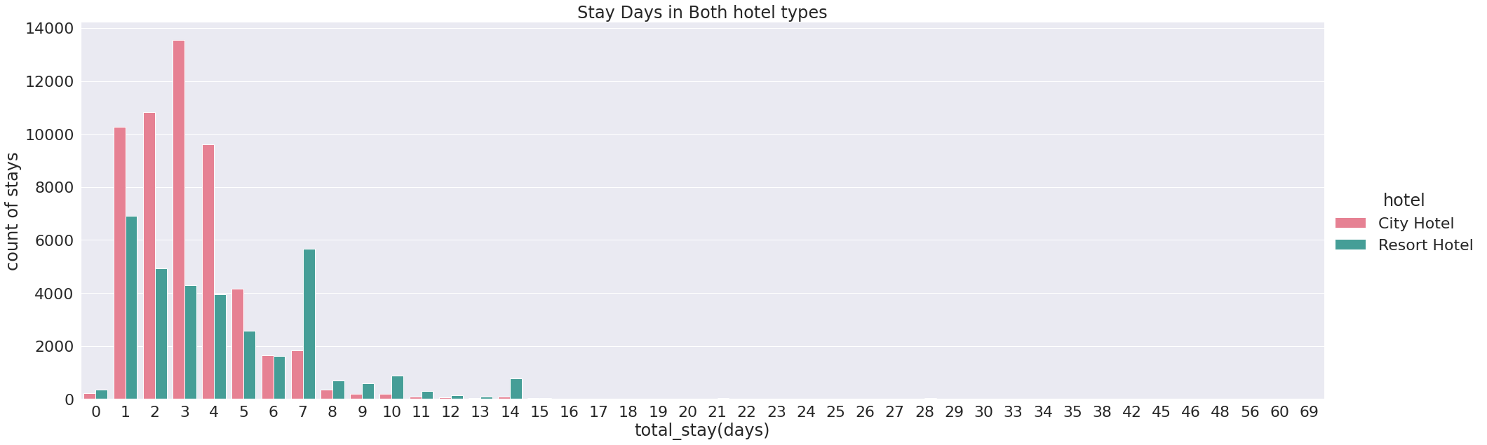
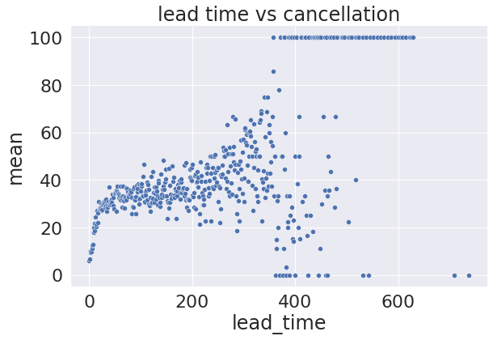
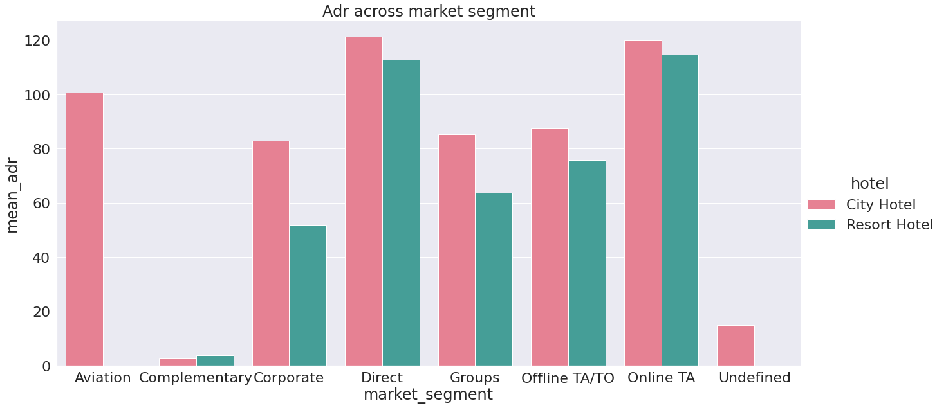
CONCLUSIONS:
Most of the People stays in these hotels are within 7 days and people staying 1 to 3 days are more in number.
'Direct' and 'Online TA' are contributing the most in both types of hotels.
Lead time has a positive correlation with the Cancellation mean as lead time increases the chances of booking get cancelled also increases.

Slide 19
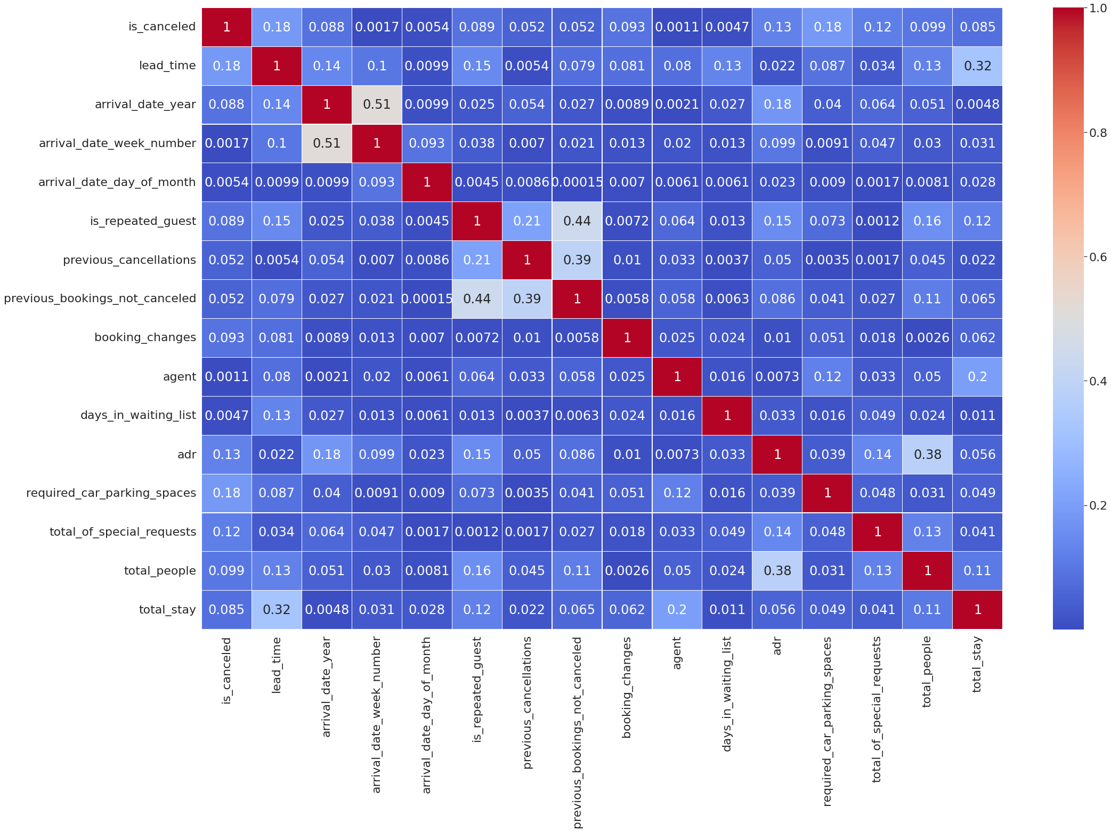
CONCLUSIONS:
Total stay and lead time is positively correlated which implies if total stay increases then lead time also increases which is quite obvious.
Repeated guest and previous booking not cancelled has correlation of 0.44 which implies old guests not cancelled most of their booking.
Adr and total stay has positive correlation which implies as the number of stay increases the adr also increases.

Slide 20
CONCLUSIONS SUMMARY:
City hotel has the most number of bookings and it is the most preferred hotel by the visitors.
BB(Bed and Breakfast) is preferred by most number of guests.
Most visitors are from Portugal(PRT) more than 25000 followed by United Kingdom(GBR) around 10000.
Distribution Channel 'TA/TO' is mostly used for booking hotels.
Most Preferred Room type is "A"
Transient Customer type is maximum While Group is minimum.
Most guest does not need parking space at all only few guest asked for parking space of one car.
Most of the guests around 80% not made any changes to the booking and around 12% of guest made one changes in their booking.
Total 27.5% of booking were cancelled out of which 30% of cancellation comes from City Hotel and 24% of cancellation comes from Resort Hotel. So,City Hotel has higher rate of cancellation.
Resort hotel has slightly higher lead time in comparison to City hotel.
2016 had been the best year for these hotels in terms of booking.
Year 2015 City Hotel and Resort Hotel had exactly same number of bookings but after 2015 City Hotel has more number of bookings.
Year 2016 City Hotel had more than 25000 bookings while Resort Hotel has around 15000 bookings whereas in 2017 City Hotel had around 20000 bookings while Resort Hotel had around 12000 bookings.
July and August months had the most Bookings.
Both the hotel has lower retention rate i.e. 3.9% in which City hotel has retention rate of 3.11% and Resort hotel has retention rate of 5.02%.

Slide 21
16. For Resort Hotel adr starts to increase from May and increases upto July after that is starts to decrease.
17. For City Hotel adr starts to increase from March and increases upto April after that is starts to decrease.
18. Lead time has a positive correlation with the Cancellation mean.
Around 25% of bookings were cancelled by guests with no deposit.
Total 69028 bookings were made by TA/TO in which 21400 were cancelled which is approximately 31%.
Online TA has around 35% cancellation rate followed by Groups which has around 27% Cancellation rate.
Distribution Channel "Direct" & "TA/TO" has contributed more in ADR in both the hotels.
Majority of people are getting room of their choices.
Only 2.5% of guest cancel the bookings if preferred room choice is not allocated.
'Direct' and 'Online TA' are contributing the most in both types of hotels
Most of the People stays in these hotels are within 7 days and people staying 1 to 3 days are more in number.
Total stay and lead time is positively correlated.
Adr and total stay has positive correlation.

Slide 22
Thank You

